Slide 1

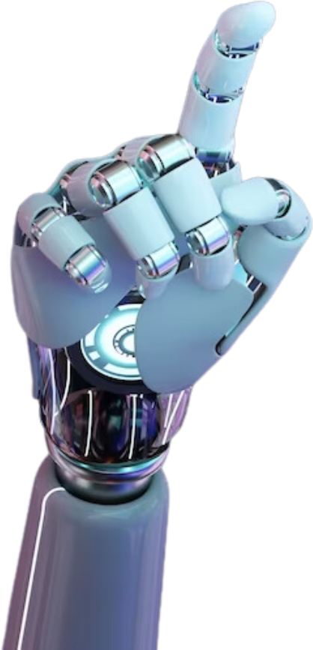
Career Boost AI

Slide 2
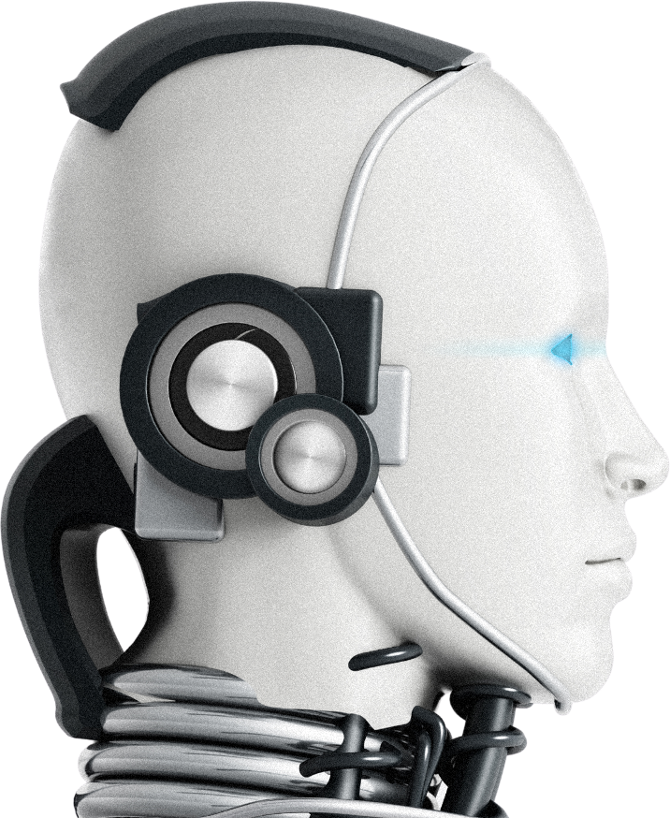
Teamname : Job Hunters
Team reference number KURU2500078
Mukesh A (AI & DS Dept)
Panimalar Engineering college
Kesav M (AI & DS Dept)
Panimalar Engineering college

Slide 3
🔹 Core Focus: AI-Powered Career Enhancement
🔹 Overall Theme:
CareerBoost AI leverages artificial intelligence to help individuals improve their career prospects and professional development through personalized insights, AI-driven coaching, and community support.

Slide 4
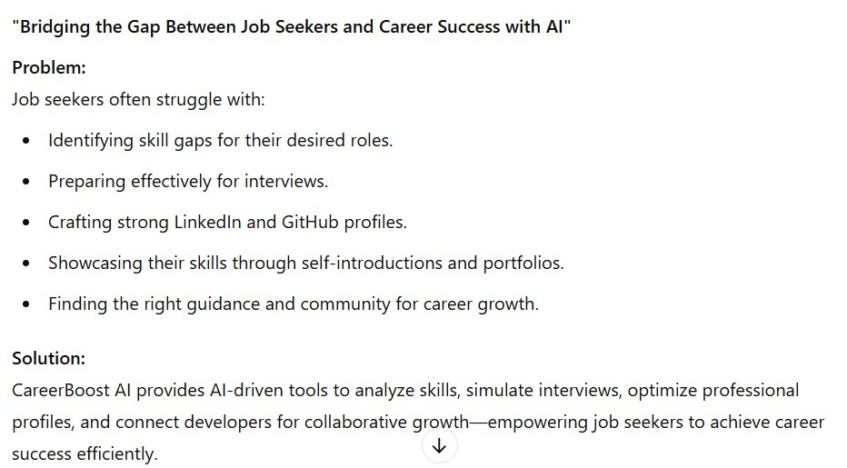

Slide 5
💡 Skill Gap Analysis – Identifies skill gaps and provides personalized recommendations.
🎤 AI Interviewer – Simulates interviews, analyzes responses, and gives real-time feedback.
📜 AI Self-Introduction – Generates compelling self-intros tailored to job roles.
📂 PortfolioPro – Helps users build an online portfolio with personalized career guidance.
🔗 LinkedIn Roast – Audits LinkedIn profiles and suggests improvements.
💻 GitHub Roast – Provides constructive feedback on GitHub projects and code quality.

Slide 6
🤖 Code Companion – AI-powered coding assistant for debugging, refactoring, and best practices.
🌍 Dev Connect – A developer community for networking, collaboration, and peer programming.
🎙 Voice-to-Voice Bot – AI-powered conversational assistant for interview prep and career advice.
🦮 Video-Based Assistance – AI-driven support for visually impaired users through computer vision and audio feedback.
📄 AI Resume Analysis – Optimizes resumes with ATS compatibility, keyword suggestions, and experience impact analysis.

Slide 7
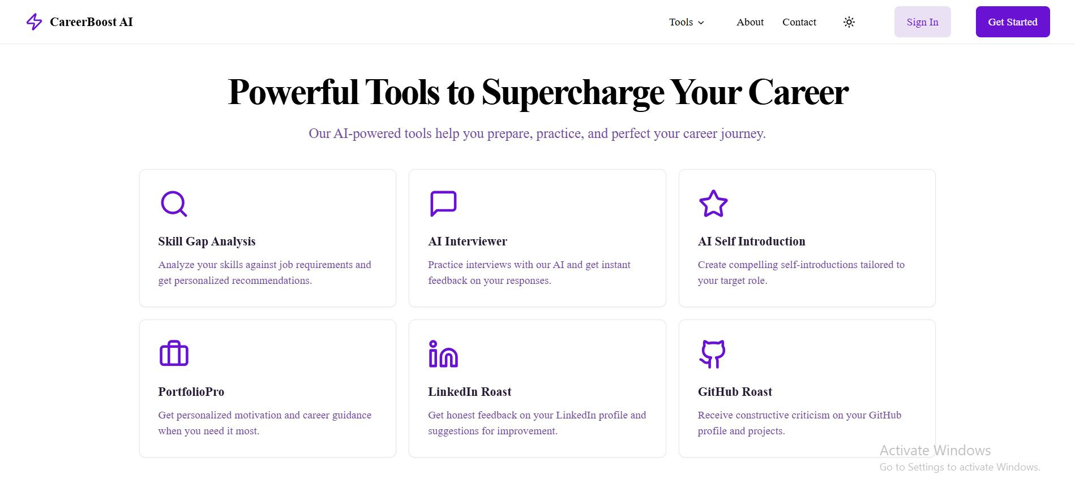

Slide 8
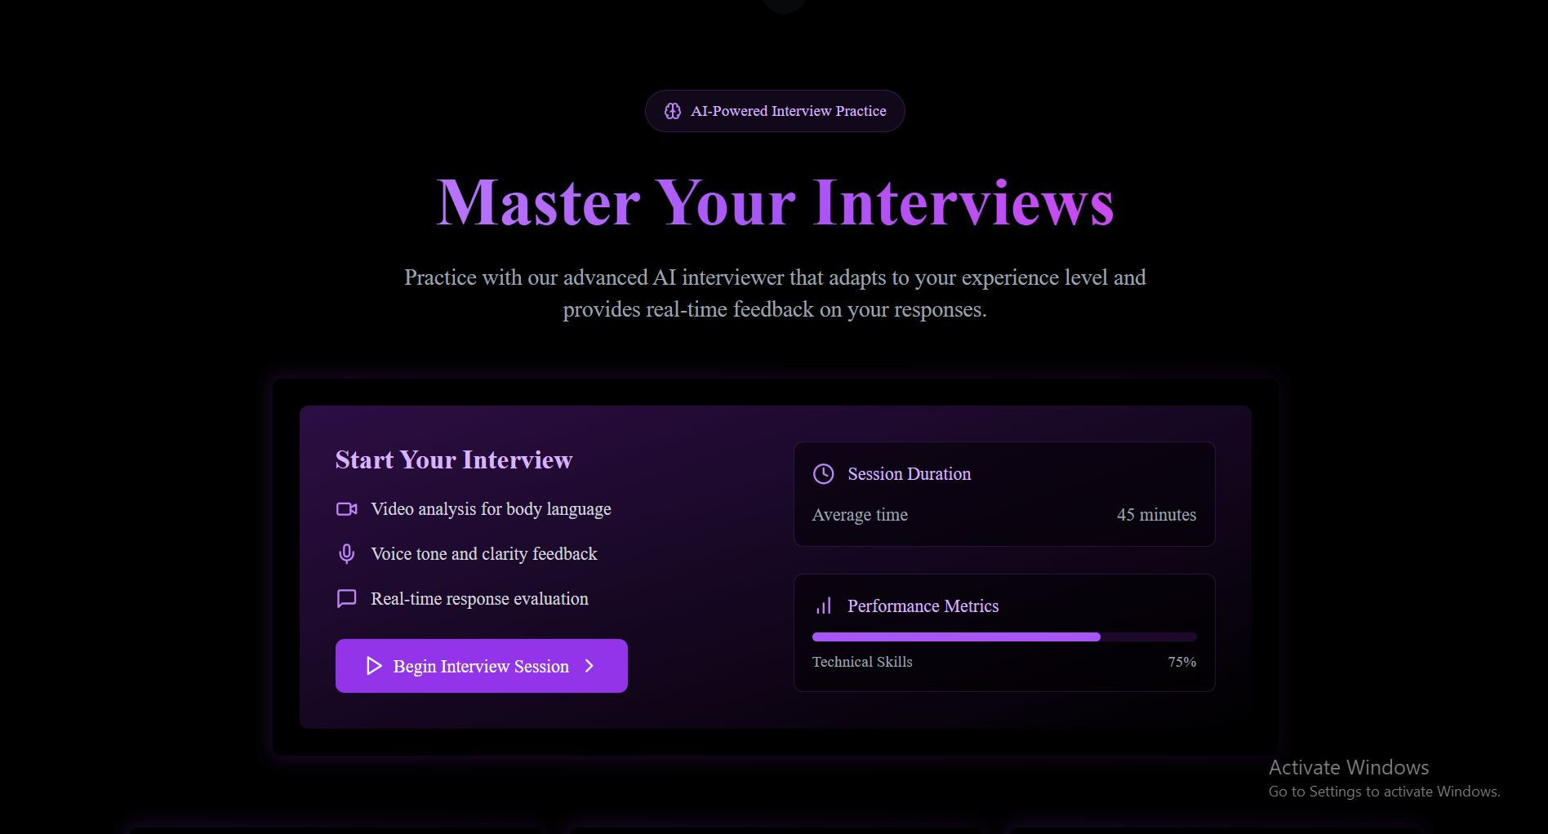

Slide 9
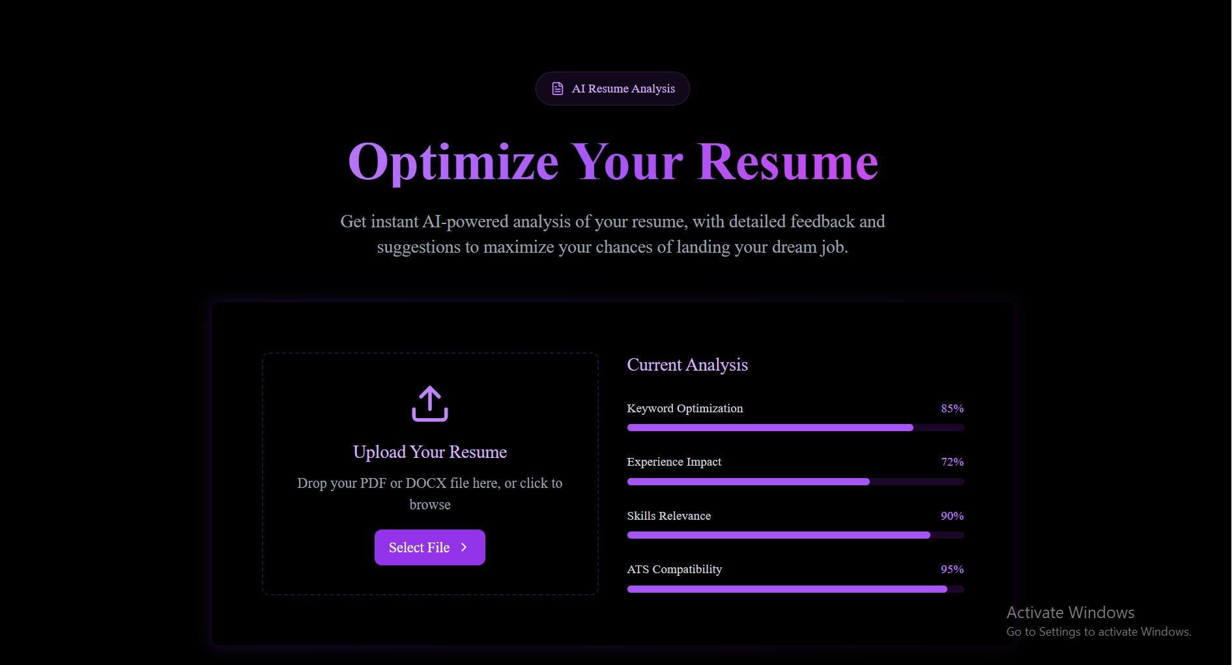

Slide 10
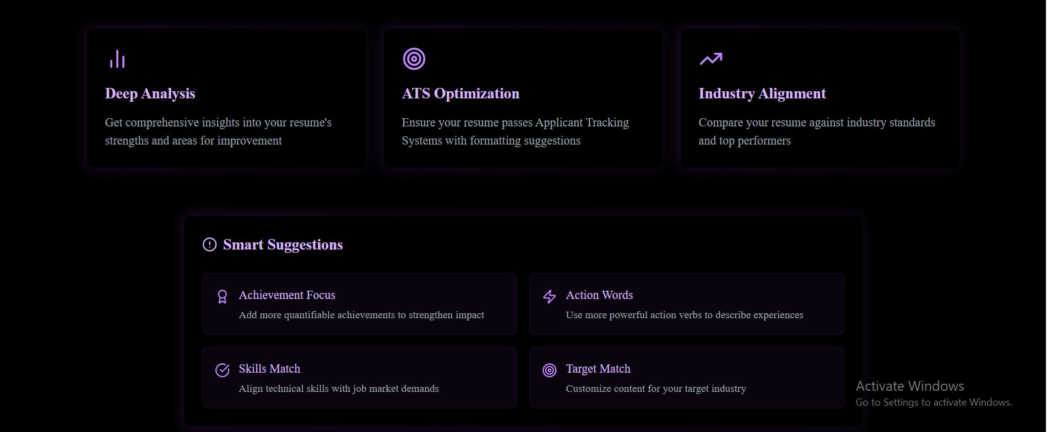

Slide 11
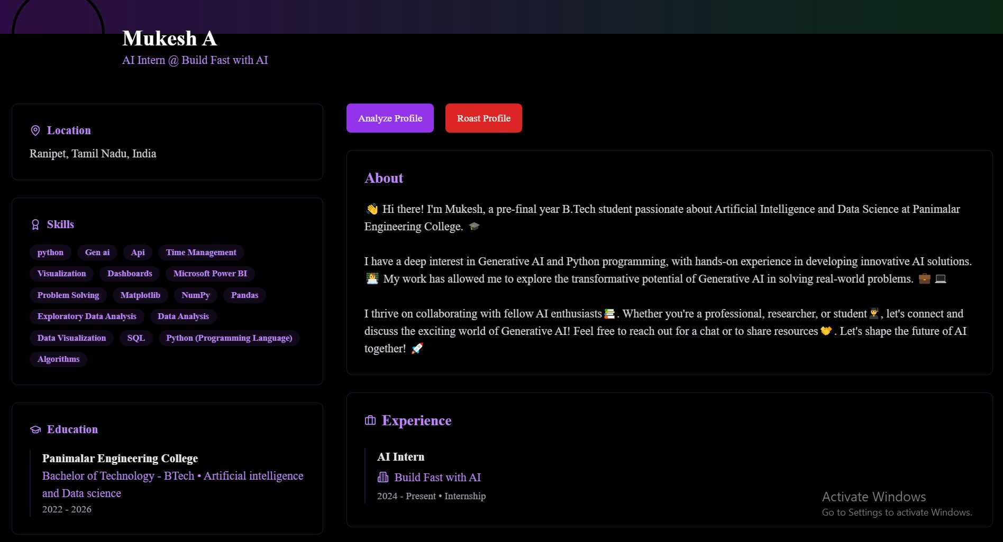

Slide 12
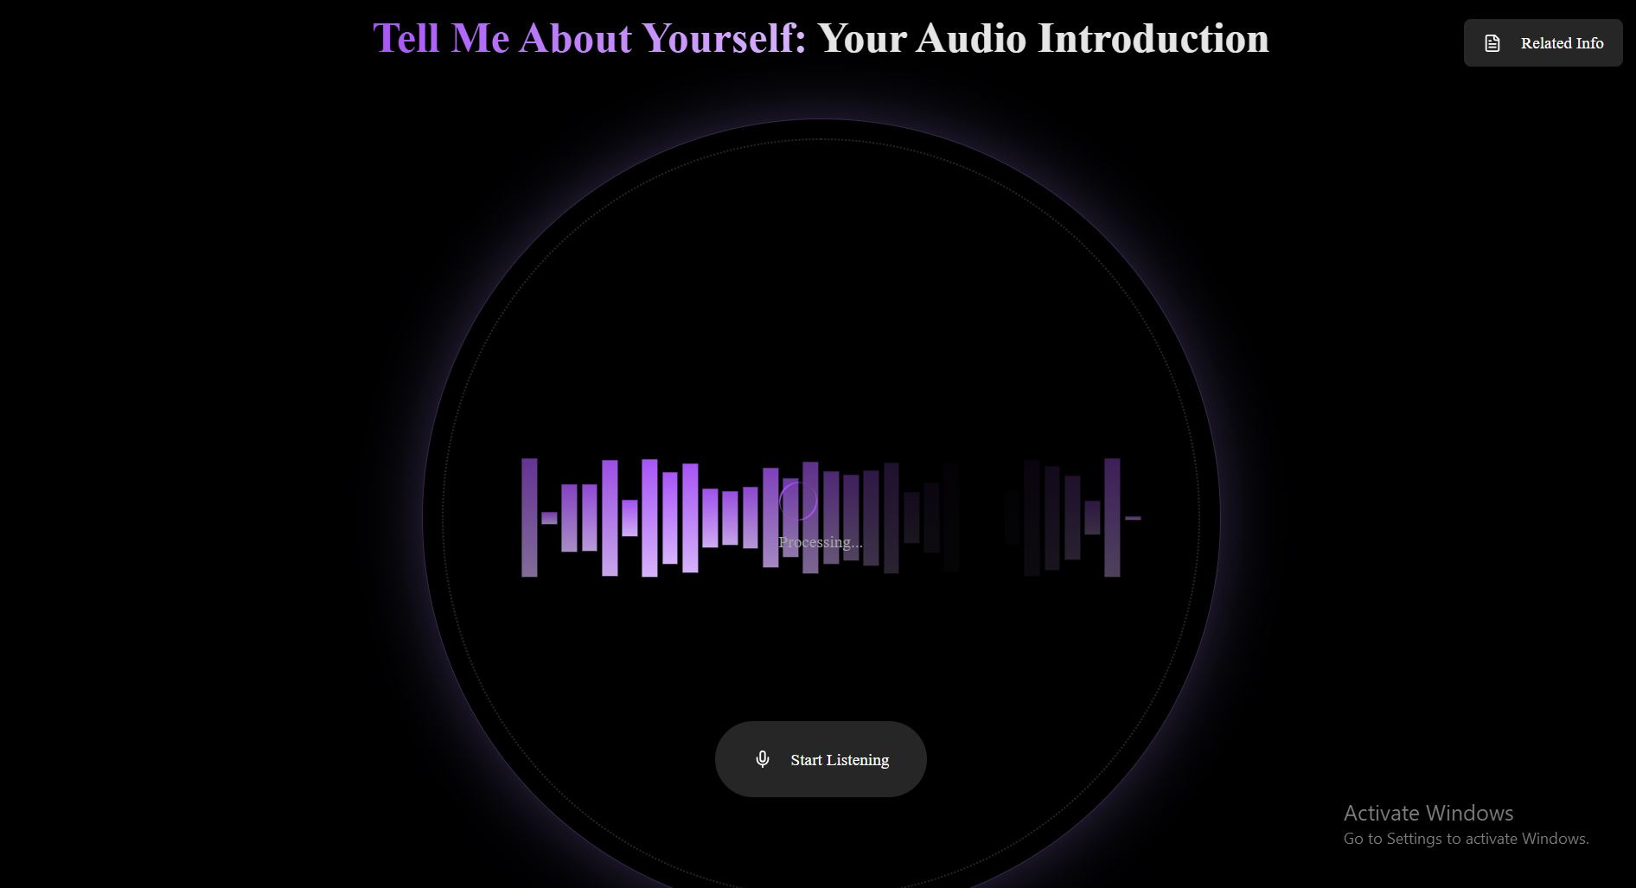

Slide 13

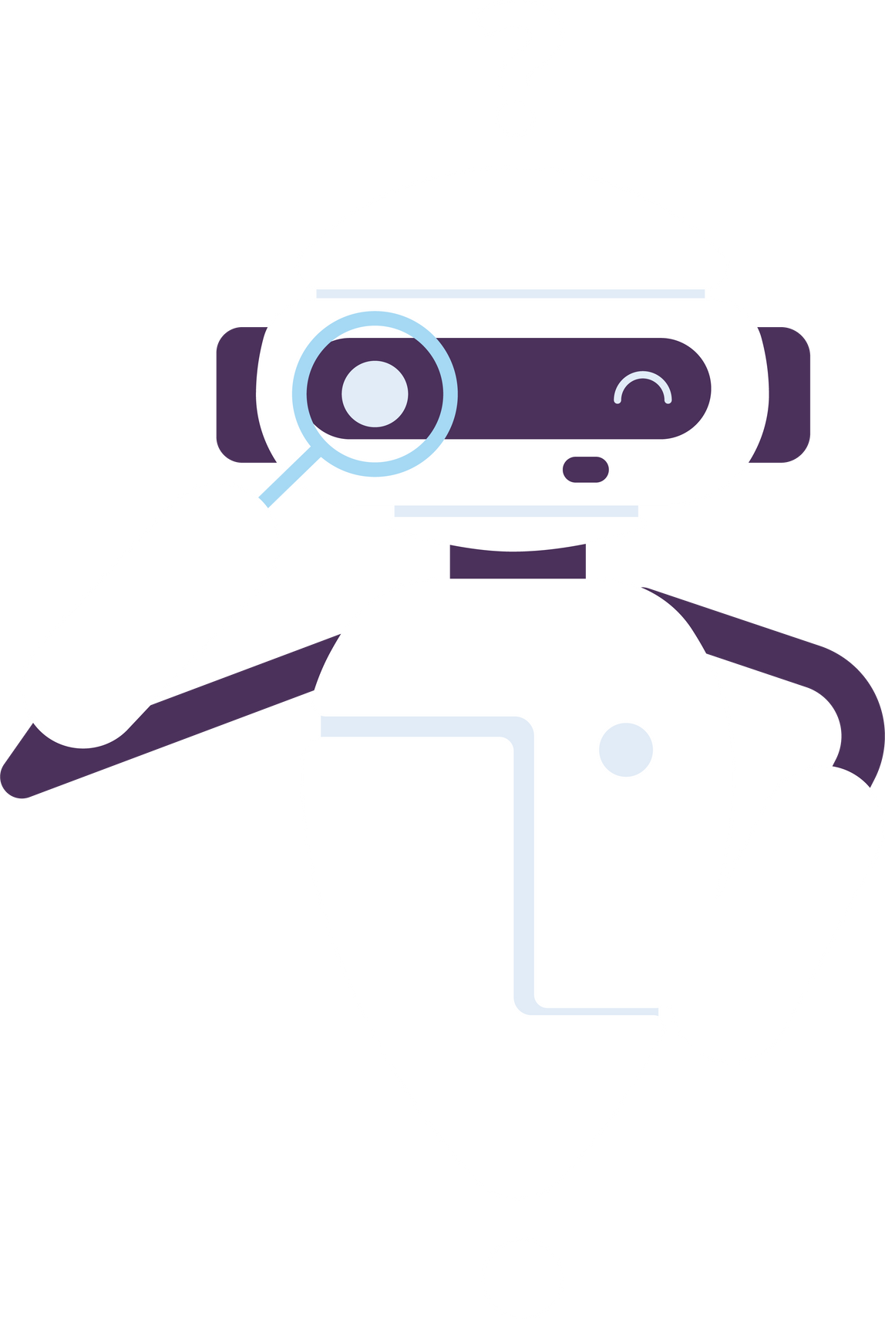
We're continuously expanding our feature set with cutting-edge developments

Slide 14
Thankyou

